Slide 1


22CSP72 – PROJECT WORK II PHASE I
Real-Time Helmet and Triple Riding Violation Detection Using YOLOv11s and ByteTrack for Smart Traffic Surveillance
DATE : 07.09.2026
TEAM ID : C06
PRESENTED BY:
NANTHITHA P - 23CSR142
NAVEEN S S - 23CSR144
PRANAAV G – 23CSR162
MENTOR : Ms S MOHANAPRIYA
Assistant Professor[SrG]/CSE
1

Slide 2
PROBLEM STATEMENT
Two-wheeler traffic violations such as helmetless riding and triple riding are common.
Manual monitoring of traffic surveillance videos is time-consuming and inefficient.
Existing systems often focus on only one type of violation.
Tracking the same vehicle/rider across video frames is challenging.
Number plate identification and violation documentation are often performed manually.
There is a need for an automated real-time traffic violation detection system.
2

Slide 3
OBJECTIVES
Detect helmet and no-helmet violations.
Detect triple-riding violations.
Track detected objects across consecutive video frames using ByteTrack.
Detect vehicle number plates.
Recognize number plate characters using PaddleOCR.
Store detected violations in a centralized database.
Generate an automatic PDF challan/report.
Develop a system suitable for real-time traffic surveillance.
3

Slide 4
LITERATURE SURVEY
Paper | Methodology | Dataset | Contributions | Limitations
Computer-Vision Based Automatic Rider Helmet Violation Detection and Vehicle Identification in Indian Smart City Scenarios Using NVIDIA TAO Toolkit and YOLOv8 (2025) | DetectNet_v2, YOLOv8 , OCR | Custom Traffic Dataset | Rider Detection, Helmet Detection, Vehicle Identification, Number Plate Recognition | No Automated Challan Generation, No Triple Riding Detection
A Deep Learning Approach for Helmet Detection and Fine Generation System (2025) | YOLOv3 ,OCR | Kaggle + Custom Dataset | Helmet Detection, Number Plate Recognition, Fine Generation | No Triple Riding Detection, No Rider Tracking
Automatic Two-Wheeler Rider Identification and Triple-Riding Detection in Surveillance Systems Using Deep Learning Models (2025) | DetectNet_v2 , YOLOv8 | Custom Traffic Dataset | Rider Detection, Triple Riding Detection | No Number Plate Recognition, No Challan Generation
4

Slide 5
LITERATURE SURVEY
Paper | Methodology | Dataset | Contributions | Limitations
Automatic Helmet Detection from Videos Using Artificial Intelligence Method and Engage with Secured Driving System by Message Alert (2025) | Adaptive YOLOv5 , ViT-DRDNet for helmet detection | Public YouTube traffic videos converted into image frames | Motorcycle detection, Helmet detection, Number plate recognition for violators, Automatic SMS/message alert to registered owner | Does not detect triple riding/passenger violations, No automatic e-challan generation
A Safety Detection Method for Electric Bike Riding Incorporating License Plate Region Recognition (2025) | F-YOLOv8 (Improved YOLOv8) integrated with Feature Pyramid Network (FPN), Transformer attention mechanism and license plate region recognition | Custom Electric Bike Dataset | Rider Detection, Helmet Detection, Vehicle Identification, Number Plate Recognition | No Automated Challan Generation, Focused only on electric bikes
Improved YOLOv8n Model for Detecting Helmets and License Plates on Electric Bicycles (2024) | YOLOv8n ,Weighted Concat, lightweight GCC convolution, OCR for license plate recognition | Custom electric bicycle dataset collected from real traffic scenes in China | Rider Detection, Number Plate Recognition | Focuses only on electric bicycles, Does not detect triple riding, No automatic challan generation
5

Slide 6
RESEARCH GAP
    Rider tracking is not available in most systems.
    Duplicate violations may occur for the same rider.
    Triple riding detection is limited.
    OCR and challan generation are not fully integrated.
    No single system combines all traffic violation modules.
6

Slide 7
ARCHITECTURE DIAGRAM
Start
OCR-Based plate recognition
Number Plate Detection
Traffic Surveillance Camera (Live CCTV / Recorded Video Stream)
Yes
Violation Database
Video Input & Preprocessing Module
Violation Detected ?
No
Violation Report Generation
YOLOv11s Object Detection Module
Triple Riding Violation
Automatic e-Challan Generation
Yes
ByteTrack Multi-Object Tracking
Riders >= 3 ?
No
Continue Monitoring
Vehicle Owner Notification
Yes
Violation Analysis Module
Helmet Worn?
No
Helmet Violation
End
7

Slide 8
PROPOSED WORK WITH PLANNED INNOVATION
Proposed Work
Planned Innovation
  Real-Time Video Monitoring
  YOLOv11s Object Detection
  ByteTrack Multi-Object Tracking
  Violation Detection
  License Plate Recognition
  Violation Report Generation
  Real-Time Helmet Detection
  Triple Riding Detection
  Accurate Multi-Object Tracking
  OCR-Based License Plate Recognition
  Centralized Violation Database
  e-Challan Integration
8

Slide 9
MODULES
  Helmet Detection
  Triple Riding Detection
  Rider Tracking
  Number Plate Detection
  Number Plate Recognition
  Violation Database
  Automatic PDF Challan Generation
9

Slide 10
DATASET
    Dataset Name : Helmet Detection
    Source : Kaggle
    Total Images : 10,838
    Training Images : 10,742
    Testing Images : 163
    Validating Images : 307
Class Labels :
0 : Plate
1: WithHelmet
2: WithoutHelmet
3: TripleRiding
10

Slide 11
ALGORITHMS
1. You Only Look Once
Algorithm Type: Single-stage Object Detection
Purpose: Detect motorcycles, riders, helmets, and no-helmet violations.
Reason for Selection:
  High detection accuracy
  Fast inference speed
  Suitable for real-time traffic surveillance
2. ByteTrack
Algorithm Type: Multi-Object Tracking (MOT)
Purpose: Track each motorcycle/rider across consecutive video frames.
Reason for Selection:
  Assigns a unique ID to each tracked object.
  Prevents duplicate violation detection.
  Maintains continuous rider tracking.
11

Slide 12
ALGORITHMS
3. PaddleOCR
Algorithm Type: Optical Character Recognition (OCR)
Purpose: Recognize vehicle registration numbers from detected number plates.
Reason for Selection:
  High text recognition accuracy.
  Supports real-time license plate reading.
  Integrates with the violation database and automatic challan generation.
12

Slide 13
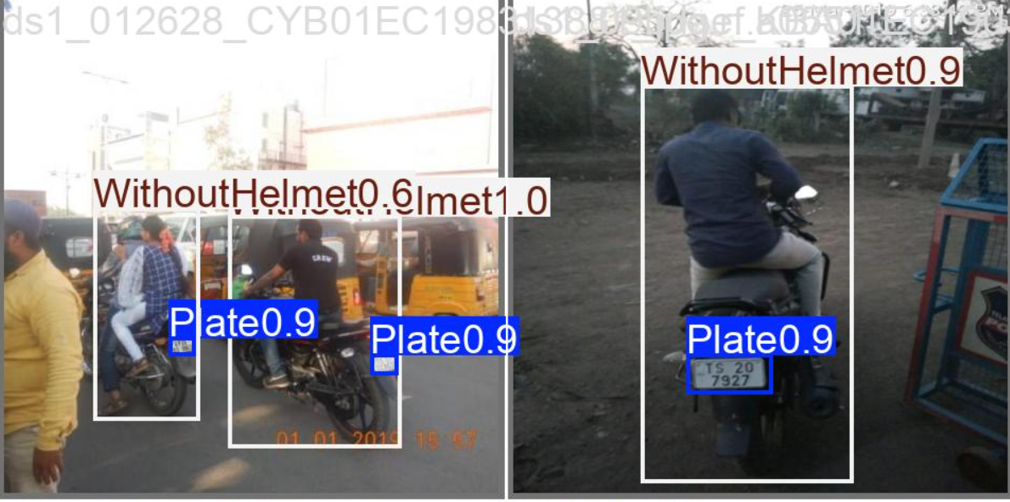
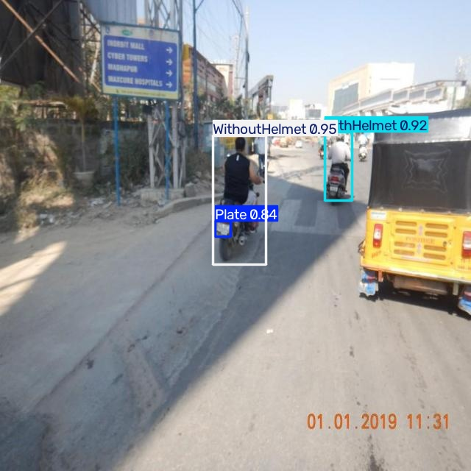
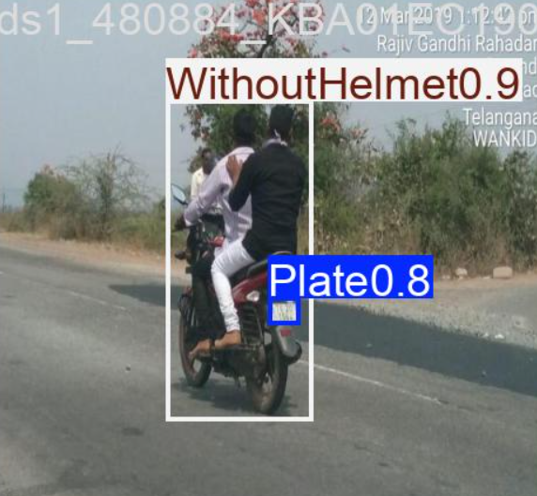
IMPLEMENTATION
13

Slide 14
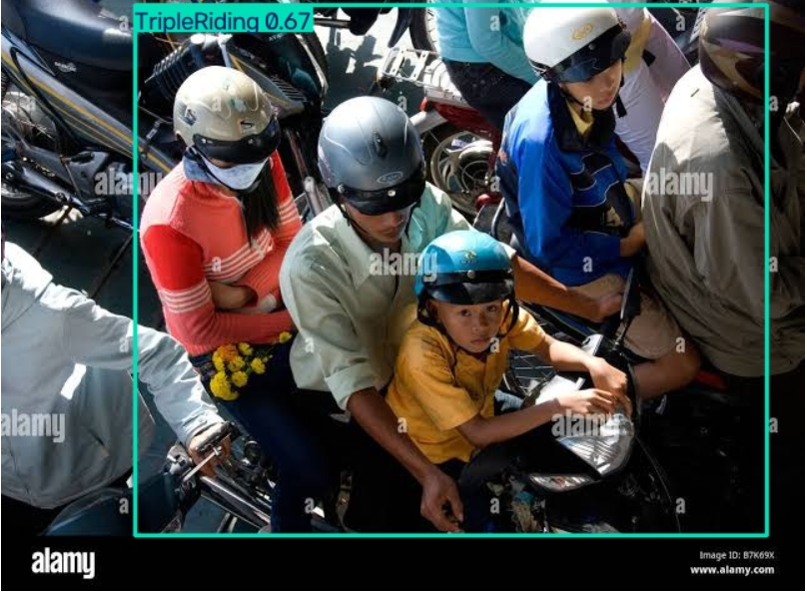
IMPLEMENTATION
14

Slide 15
BASELINE COMPARISON
Parameter | YOLOv8n | YOLOv11s
Model Type | Single-stage detector | Single-stage detector
Model Size | Nano | Small
Detection Speed | Fast | Fast
Detection Capability | Baseline | Proposed
Classes | 4 current classes | 4 current classes
Precision | 82.26% | 81.86%
Recall | 74.91% | 76.60%
mAP@50 | 78.29% | 79.90%
mAP@50–95 | 54.04% | 57.14%
15

Slide 16
COMPLEXITY AND COST
Computational Complexity
YOLO11s performs single-stage object detection.
Processes frames independently for detection.
ByteTrack adds tracking computation across frames.
PaddleOCR adds text recognition after plate detection.
Overall computational requirement depends on video resolution, FPS and number of objects.
Cost
Component | Cost
Dataset | Public datasets
Software | Open-source
YOLO11s | Open-source framework/model
ByteTrack | Open-source
PaddleOCR | Open-source
Cloud GPU | Depends on usage
Deployment | Camera/GPU dependent
16

Slide 17
THANK YOU
17

